Slide 1
Forged Currency Predictor using Neural Nets
Group 3

Slide 2
What & Why…….??
Counterfeit money is imitation currency produced without the legal sanction of the state or government usually in a deliberate attempt to imitate that currency and so as to deceive its recipient.
Forged Currency notes possesses a threat to economy on a global scale in ways like:
Devaluation of currency and inflation.
Black marketing
Dumping of goods at cheaper rates
Non-reimbursement by banks.
Loss of public confidence.

Slide 3
The problem
To detect forged currency notes.
The fake bills can be hard to spot with an untrained eye, and sophisticated digital printers have made it easier for criminals to create higher-quality bad bills, filter. And the problem appears to go growing.
In India, after demonitization the instances for fake currency usage doubled, which increased the need to find better ways to detect fake currency.

Slide 4
Project objective
With this project we aim to help the local businesses against currency fraud which may lead to huge personal as well as economic loss.

Slide 5



Target audience
The project will find utility with small businesses which can include - grocery stores, petrol pump stations, and other businesses with similar transaction limits.
The model’s implementation also helps the general economy by increasing the confidence in the currency and reducing inflation.

Slide 6
Description of the model
Our dataset is a CSV file that contains information extracted from (wavelet transformed) images of banknotes. There are 1,372 banknotes, each with the following attributes:
Image.Var (Variance of Wavelet Transformed image (WTI))
Image.Skew (Skewness of WTI)
Image.Curt (Curtosis of WTI)
Entropy (Entropy of image)
Class (Whether or not the banknote was authentic)

Slide 7
Data Gathering
Calculating projections along the x and y axes of an image.
Standard deviation, skewness, kurtosis.
These steps are repeated for all the images of currency notes and the dataset is prepared.
We got the preprocessed currency notes dataset from UCI repository.

Slide 8
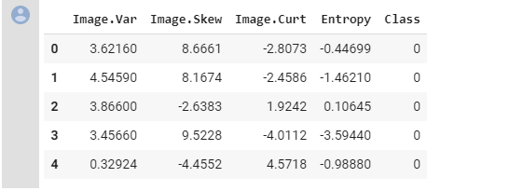
bank_notes.head()

Slide 9
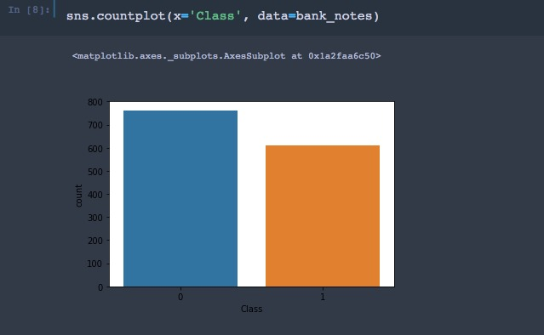
Exploring data:
We use Seaborn’s countplot to see how many fake and real banknotes are there in the dataset .

Slide 10
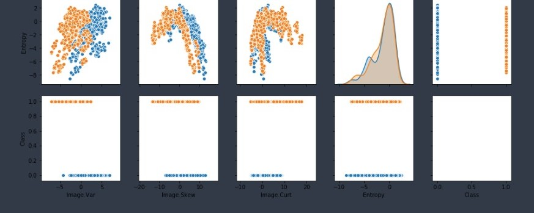
In addition to it, we find the relationship between the attributes by using pairplot() from Seaborn .

Slide 11
Data Preparation
Standardization of data using Normalization.
Splitting the class attribute into 2 columns - “Forged” and “Authentic”.
Using Scikit-learn split the data into training and test set in the ratio 70:30.

Slide 12
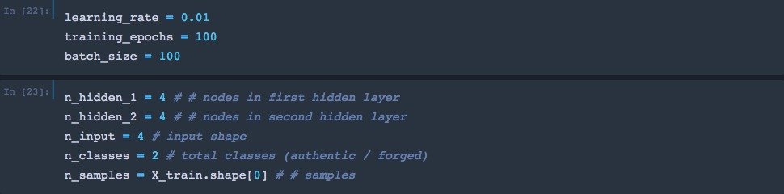
Parameters
Below are the parameters which we need to compute the cost and update the gradients so as to obtain the minimized cost, hence better accuracy.

Slide 13
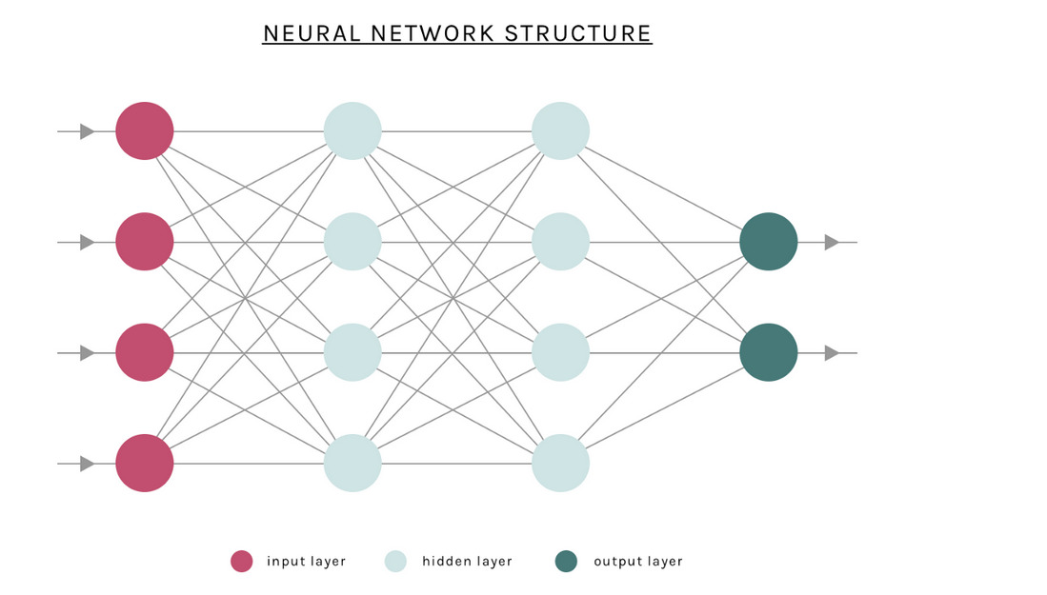

Slide 14
Parameter Tuning
The input feeded into the Tensorflow graph x and y can be defined as matrix
We need to define the weights and bias for each layer in our network. We will create dictionaries of weights and biases using the parameters we have already defined.
Our network will have 3 layers (2 hidden layers and an output layer, excluding the input layer).

Slide 15
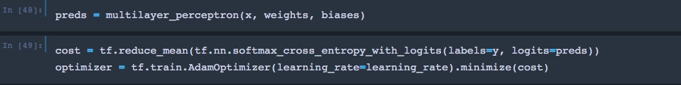
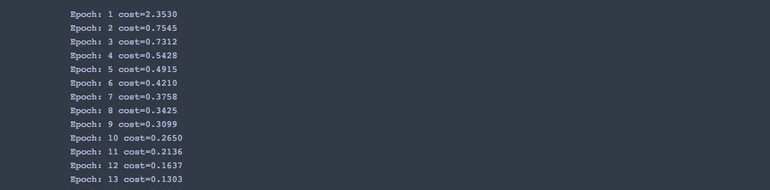
Cost and Optimization
Optimization was achieved by:
using the softmax cross entropy to calculate cost.
Adam optimiser to minimize cost.

Slide 16
Construction of Neural Network
We create a function that accepts the input x , a dictionary of weights and dictionary of biases.
For Activation function we used ReLu activation function.

Slide 17
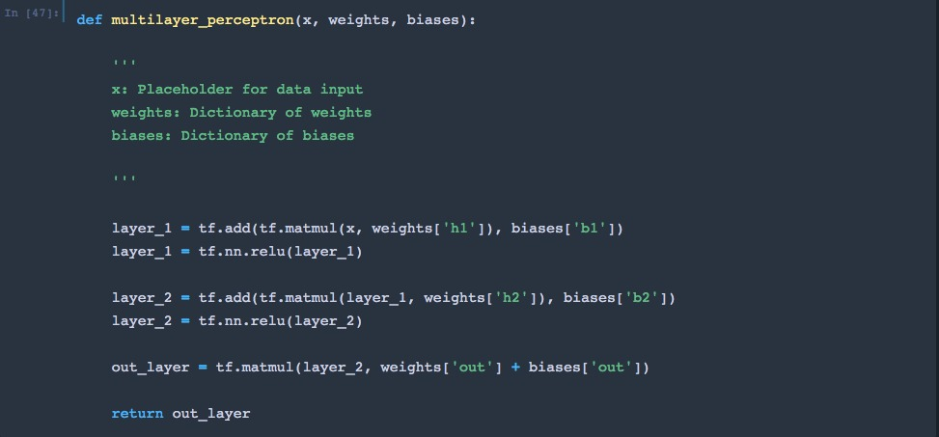

Slide 18
Training the Network
We have two loops in training:
The outer loop runs the epochs.
The inner loop runs the batches for each epoch.
After each epoch, we can print on the cost and append it to a list of costs. The way we can plot a line graph after training to visualise how our cost has been minimized.
Accuracy of the MLP 95 %.

Slide 19
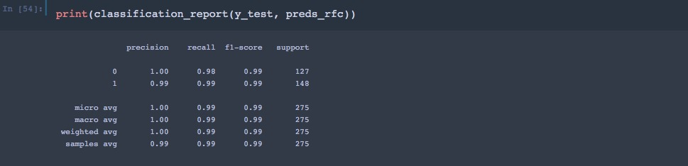
Model Evaluation and Comparing Models
After training , the accuracy of the model comes out to be : 95%
The model is then compared to Random Forest Classifier and confusion matrix is created.

Slide 20
Conclusion
Applying these two models we have demonstrated the feasibility of using multi layer perceptron to detect counterfeit notes. The process of detection of fake notes easy and quick under the trained data. By this we can ensure that under real and large data set the model can be trained and provides accurate results, which can help the people in recognising the fake currency and help in strengthening the economy.

